Slide 1
WSGI Demystify
Building restful service based on wsgi

Slide 2
Why to learn it ?
Python Web Server Gateway Interface
Author: Phillip J. Eby
PEP0333, v1.0, 2003
PEP3333, v1.0.1, 2010
All OpenStack APIs are based on WSGI

Slide 3
Agenda
I, Where is WSGI in web development stack ?
II, WSGI in detail
Stones: Gateway, Application and Middleware
Wheels: WebOb, Routes, PasteDeploy
III, Example in OpenStack
Keystone, Glance and Cinder
IV, Compare to Django
A “full-stack” web development framework

Slide 4

Part I, Where is WSGI ?

Slide 5
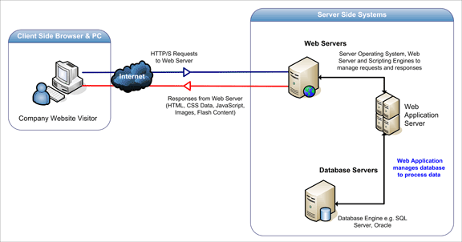
Review: What really happens when you navigate to a URL
http://igoro.com/archive/what-really-happens-when-you-navigate-to-a-url/
Notes:
Prerequisites: TCP/IP, Socket, HTTP(GET/POST/PUT/DELETE/PATCH)

Slide 6
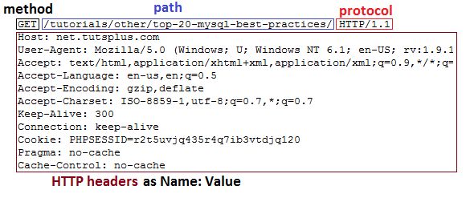
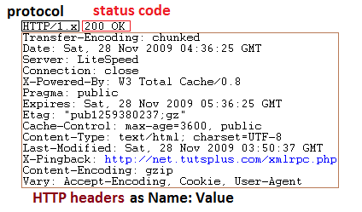
Review: HTTP
http://code.tutsplus.com/tutorials/http-headers-for-dummies--net-8039
Notes:
Request: request line, header, body
URL
Methods: GET, POST, PUT, DELETE, PATCH
Response: status line, header, body
200, 301, 302, 401, 403, 404, 500
<HTML>
MIME:
text/html, text/plain, text/javascript, text/css
Application/json
Image/jpg, image/png
Video/xxx
Flash, embedded

Slide 7
Review: RESTful (Representational State Transfer) API
A style, Not a standard
The World Wide Web is a REST system
Method | Collection URI http://example.com/resources | Element URI http://example.com/resource/item17
GET | List all members in collection | Retrieve a specific member
PUT | Replace entire collection with another collection | Replace the member or Create it if it doesn’t exist
POST | Create a new member in the collection
DELETE | Delete the entire collection | Delete the member
Notes:
Base URL
Media Type: e.g. JSON, XML
HTTP Methods: e.g. GET(safe), PUT, POST or DELETE
Collection and Element URI

Slide 8
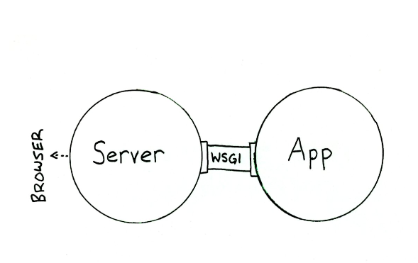
Where is WSGI ?

Slide 9
Quiz ?
Can WS protocol runs in WSGI ?
I have a web site based on Django, and I want to add WS support. What should I do ?

Slide 10
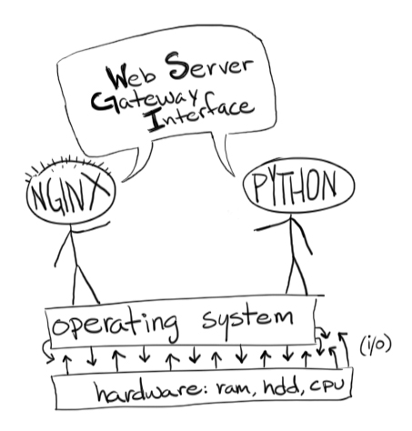
Part II, WSGI in detail

Slide 11
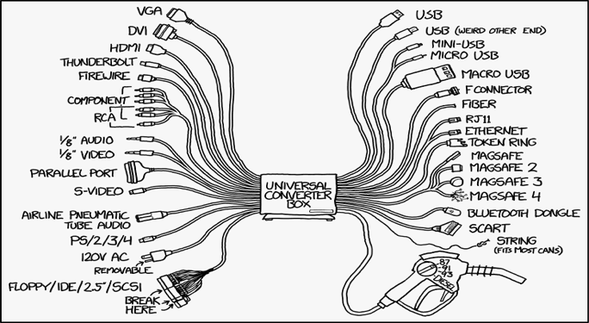
So many choices !
Gateway interface
Rack(Ruby), PSGI(Perl), JSGI(Javascript), Servlet(Java)
CGI, FastCGI, SCGI, mod_python, uwsgi
Web servers
Apache, Nginx, uwsgi/gunicorn/twisted/gevent
Web frameworks
Django, Flask, bottle, webpy, Tornado, Pylons, Zope
Different patterns
Multiple processing/threading, event-driven

Slide 12
Application (Framework) side
def application(environ, start_response):
start_response(‘200 OK’, [(‘Content-Type’, ‘text/html’)])
return [‘Hello’, ‘WSGI’]
Notes:
Callable with two parameters
Start_response, status, headers
Iterable body (yield -> stream) -> generator

Slide 13
Gateway (Server) side
def run_with_cgi(application):
environ = {k: unicode_to_wsgi(v) for k,v in os.environ.items()}
...
def start_response(status, response_headers):
...
result = application(environ, start_response)
for data in result:
write(data)
if not headers_sent:
write('') # send headers now if body was empty
https://www.python.org/dev/peps/pep-3333/#the-server-gateway-side
Notes:
For each request call app once. Write headers and body

Slide 14
Environ
A dict from string to string. Contains CGI environment variables
Required variables
REQUEST_METHOD: GET, POST etc.
SCRIPT_NAME vs. PATH_INFO: Initial portion and remainder of the request’s URL’s path.
QUERY_STRING: the portion of URL follows ‘?’
CONTENT_TYPE, CONTENT_LENGTH
SERVER_NAME, SERVER_PORT, SERVER_PROTOCOL
HTTP_*: request headers, i.e. HTTP_AUTHENTICATION

Slide 15
Environ (2)
WSGI-defined variables
wsgi.version
wsgi.url_schema: e.g. http or https
wsgi.input: input stream, read body of request
wsgi.errors: output stream, for error recording
wsgi.multithread: True if app may be invoked by another thread simultaneously
wsgi.multiprocess: True if app may be invoked by another process simultaneously
wsgi.run_once: True if gateway expect the app will only be invoked one time
Customized variables
mod_python.some_variable
wsgiorg.routes_args

Slide 16
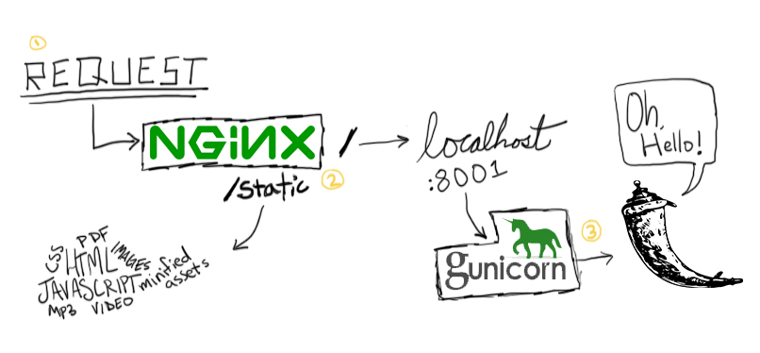
Example: show_env_app.py

Slide 17
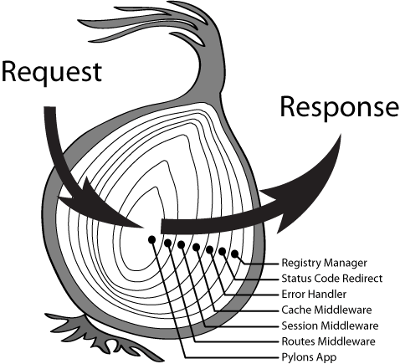
Middleware: Play Both Sides
https://www.python.org/dev/peps/pep-3333/#middleware-components-that-play-both-sides

Slide 18
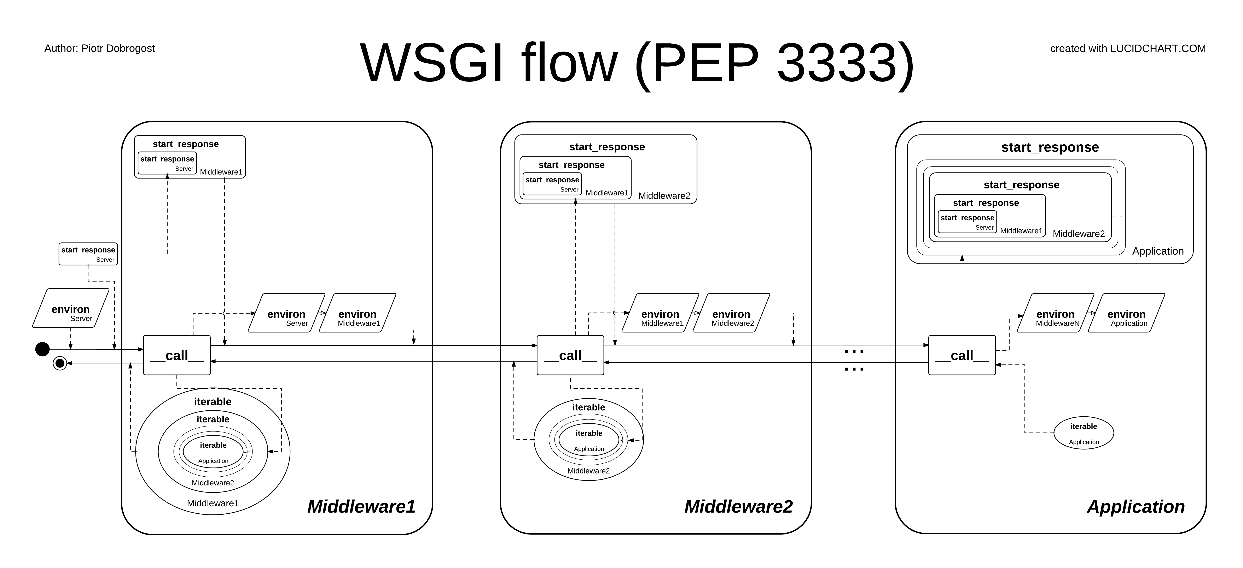

Slide 19
Example: HTTP Basic Auth Middleware
Headers:
Response: WWW-Authenticate
Request: Authorization
Status code:
401 Not Authorized
403 Forbidden

Slide 20
Quiz ?
Describe the specification detail for WSGI applications.

Slide 21
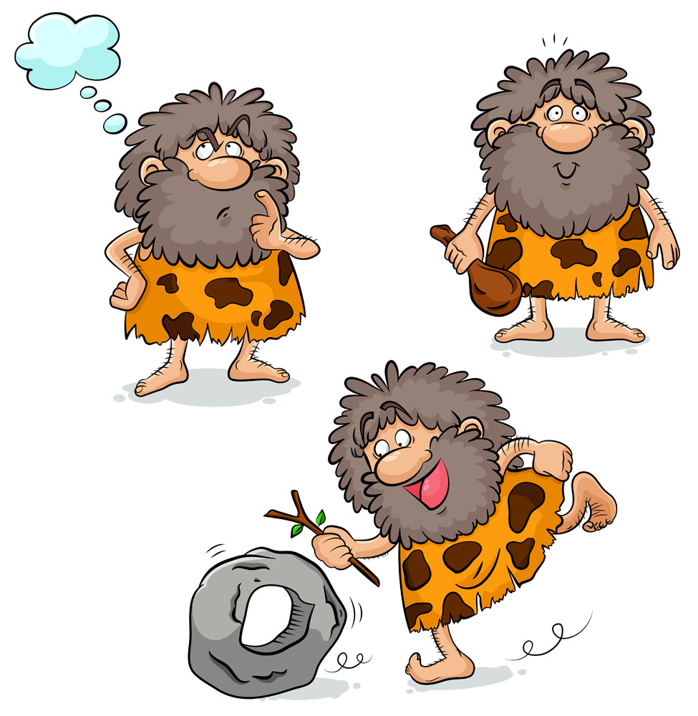

Slide 22
WebOb – WSGI request and response object
Request
req = webob.Request(environ)
req.method, req.body, req.script_name, req.content_type
req.headers[‘Content-Type’]
req.GET[‘check’], req.POST.items()
req.cookies[‘sessionid’]
req.call_application(app) -> (‘200 OK’, [(‘Content-Type’, ‘text/plain’)], [‘Hi’])
Response
res = webob.Response()
res.status = 404
res.header[‘foo’] = ‘bar’
res.charset = ‘utf8’
res.body_file.write(‘hey’)
res.set_cookie(‘key’, ‘value’)
res = req.get_response(app)

Slide 23
Routes – mapping URLs to action
# matching
>>> map = routes.Mapper()
>>> map.connect('show_user', '/user/{id}', controller='user', action='show')
>>> map.match('/user/33')
{'action': u'show', 'controller': u'user', 'id': u'33'}
# generation
>>> routes.url_for('show_user', id=13)
'/user/13'

Slide 24
Routes (2) - RESTful services
>>> map.resource('message', 'messages')
>>> print map
Route name Methods Path Controller action
POST /messages.:(format) messages create
POST /messages messages create
formatted_messages GET /messages.:(format) messages index
messages GET /messages messages index
formatted_new_message GET /messages/new.:(format) messages new
new_message GET /messages/new messages new
PUT /messages/:(id).:(format) messages update
PUT /messages/:(id) messages update
DELETE /messages/:(id).:(format) messages delete
DELETE /messages/:(id) messages delete
formatted_edit_message GET /messages/:(id)/edit.:(format) messages edit
edit_message GET /messages/:(id)/edit messages edit
formatted_message GET /messages/:(id).:(format) messages show
message GET /messages/:(id) messages show

Slide 25
PasteDeploy – a system for finding and configuring WSGI apps and servers
INI config
Composite app
/ → main app
/admin → admin app
Filter (Middleware): Pre/post processing
Pipeline: filter1 → filter2 → ... → app
>>> from paste.deploy import loadapp
>>> app = loadapp('config:/some/conf.ini')

Slide 26
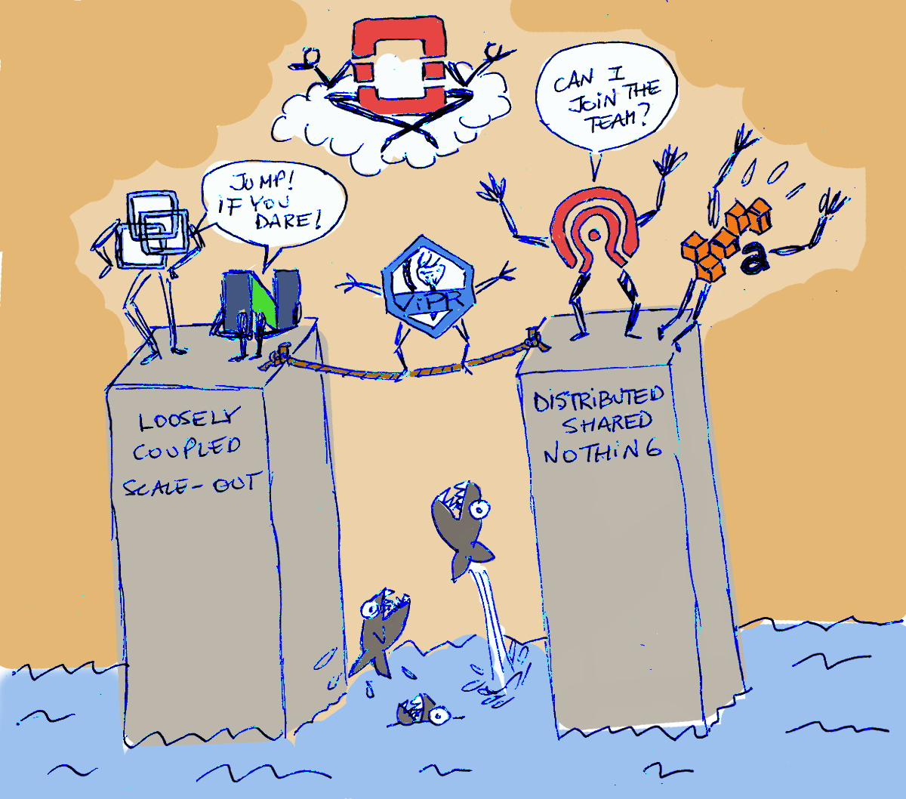
Part III, Example In OS

Slide 27

Keystone
http/wsgi-keystone.conf
http/keystone.py
keystone.server.wsgi:initialize_application(“main”|”admin”)
deploy.loadapp(conf, name=“main”|”admin”)
etc/keystone-paste.ini
api_v3 → service_v3 → keystone.service:v3_app_factory
wsgi.ComposingRouter
wsgi.Router._router → routes.middleware.RoutesMiddleware
http://git.openstack.org/cgit/openstack/keystone/tree/httpd/wsgi-keystone.conf

Slide 28
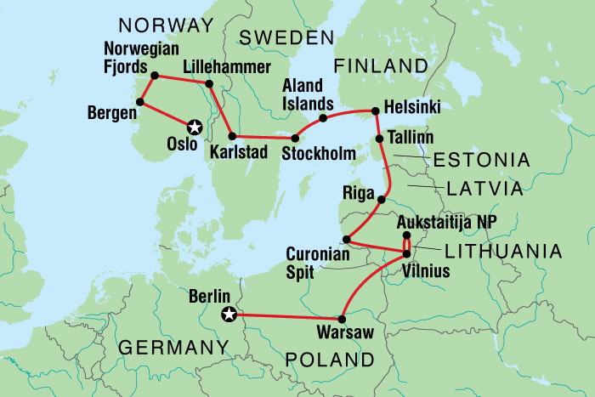


Middleware
oslo.middleware
RequestId
RequestBodySizeLimiter
Debug
CorrelationId
CacheErrors
DisableByFileHealthcheck
Notes:
据说，奥斯陆原意为“上帝的山谷”，又一说意为“山麓平原”

Slide 29
Middleware (2)
keystone.middleware
AuthenContextMiddleware
TokenAuthMiddleware
JsonBodyMiddleware
NormalizingFilter
keystone.contrib
AccessLogMiddleware
EC2Extension
S3Extension

Slide 30
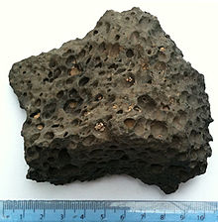
Cinder
etc/api-paste.ini
openstack_volume_api_v2 → apiv2 → cinder.api.v2.router:APIRouter
cinder.wsgi.Router
Glance

Slide 31

Swift
etc/object-server.conf-sample
setup.cfg#entry_points
swift.obj.server:app_factory
swift.obj.server:ObjectController.__call__

Slide 32

Part IV, vs. Django

Slide 33
Feature | Django | Flask | Tornado | Stand-alone
URL mapping | • | • | • | Routes
Request & Response objects | • | • | • | WebOb
MVC | • | • | •
ORM | • |  |  | SQLAlchemy
Template engine | • |  | • | Mako,Jinja2
Caching | • |  |  | Memcache
Security | • |  | •
Form | • |  |  | Deform
Scaffolding
Testing | • | • | • | Unittest,Pytest,Nose,Tox
Server |  |  | • | uWSGI,Gunicorn,Gevent,Twisted
Auth & Auth | • |  | •
Req&Res Middleware | • |  |  | PasteDeploy
Frontend support: JS/CSS/Ajax | •
Web Socket |  |  | • | Websockets

Slide 34
Thanks!

